Slide 1
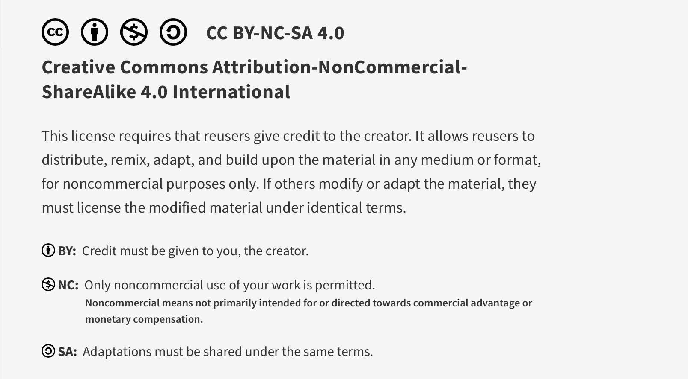
This work is licensed under CC BY-NC-SA 4.0. To view a copy of this license, visit: https://creativecommons.org/licenses/by-nc-sa/4.0/

Slide 2

Resource Stewardship
Lucie Filteau, MD, FRCPC
PGY 2-4 Academic half day
QPS Series

Slide 3
Ottawa Anesthesia QPS Curriculum
PGY 1
PGY 2-4
Intro to Safety
Handover
Stress and Substance Abuse
IPAC Session
Positioning Workshop
Intro to Quality Improvement 1
Intro to Quality Improvement 2
Systems Thinking and Design
Human Factors
Resource Stewardship
Situational Awareness, Teamwork and Communication

Slide 4
Anesthesia Examples of Resource Waste
(Consider anesthesiologists as a valuable Resource in short supply)

Slide 5
Types of Resource Waste to Consider
Money, materials
Skills
Time
Machine, staff and information downtime
Energy
Unnecessary/redundant tasks, unnecessary movement/efforts (of staff, materials, patients)
Supply/demand mismatches

Slide 6
Money, Materials
Equipment/medication preparation
Phenyl bags for healthy pt list?
Equipment/medication use
O2 masks for transport to PACU?
Ondansetron for an 80 yr old male for ORIF ankle?
Testing
Postop CBC (after 500 cc blood loss)?
Postop glucoscan on diet control diabetic with normal preop Glu?

Slide 7
Skills
Underutilization of skilled staff
AA’s assisting you by handing you tape?
RN’s to hand surgical instruments?
Overly skilled staff used for “lower-level” tasks
OR setup done by anesthesiologist?

Slide 8
Time/Energy
45 min wait between cases (inpatient transport delay)
Running around getting missing equipment in a.m.
Pressure bags
Temp probes
Infusion pumps
Excessive/redundant EPIC steps for simple tasks

Slide 9
Harms of Overuse (Investigations/Tx’s)
Individual Patients
Physical (A/E’s, incidental findings)
Psychological (anxiety, fear)
Financial (e.g. missed time from work)
Health Care System
Pressure on providers
Increased wait times
Costs of wasted resources
Adapted from Brownlee et al. 2018 The Lancet, 390 , 10090, 156 – 168.

Slide 10
Additional Harms of Wasted Resources
Environmental waste
Planetary harm
Pressure on providers
Illness, burnout, dropout
Wait times/backlog
Worsening health of patients, pressure on ER’s
Introduction of non-physician providers, less safe care ratios
High care costs
Insufficient funding for demands, deteriorating healthcare system

Slide 11
Barriers to Stewardship

Slide 12
Why does overuse happen?
Failure to recognize harms
Culture of “more is better”
Volume driven system and financial gain
It’s the way we have always done things
Unease with uncertainty
Poor knowledge of evidence (or poor adherence to guidelines)
Time constraints
Satisfying referring colleague’s requests
Pre-emptive ordering for efficiency
Marketing by hospitals, pharmaceutical companies, device makers
Defensive medicine
Patient and family request and expectations

Slide 13
Why does overuse happen? Possible additional factors among Residents
Lack of confidence in clinical assessment
Desire to impress supervisor
Need to rule out “zebra”
Better to do something than “nothing”
Curiosity and/or desire to gain experience/knowledge
Lack of reinforcement for exercising restraint

Slide 14
How Do We Overcome Barriers to Stewardship?

Slide 15
Stewardship Interventions (larger scale)
Education
1:1 teaching, wider campaigns
Audit and feedback
Identify outliers (top/bottom performers)
Forced constraints
Decision rules
Development of protocols/guidelines
Automation
Defunding

Slide 16
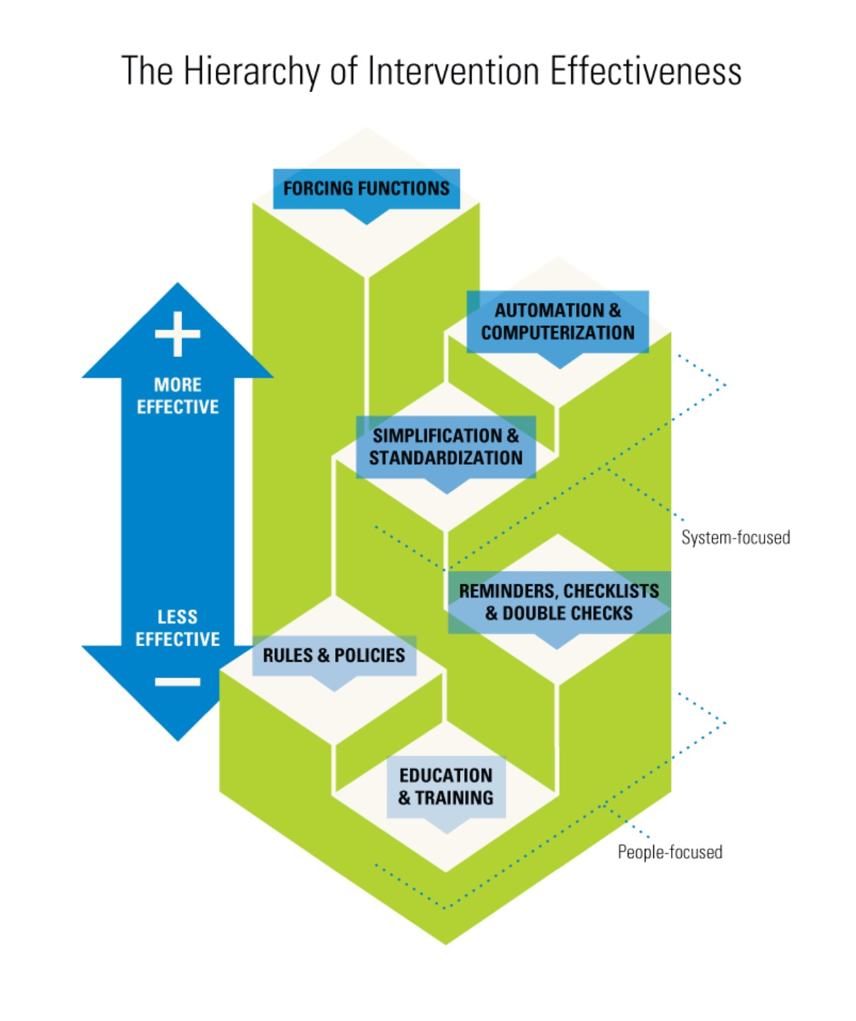
Hierarchy of Intervention Effectiveness
Forcing functions
Automation
Standardization
Checklists
Policies
Education/training
Diagram created by Cassie McDaniel

Slide 17

Preoperative Investigations at The Ottawa Hospital
At TOH, before CWC Initiatives (pre-2014)…
No protocols, medical directives for preop testing
Testing manually ordered by surgeons, anesthesiologists
Most patients would get tests
EKG, CXR, CBC/lytes/creat/coags, Type & CM, urine C+S
++ wastage!

Slide 18
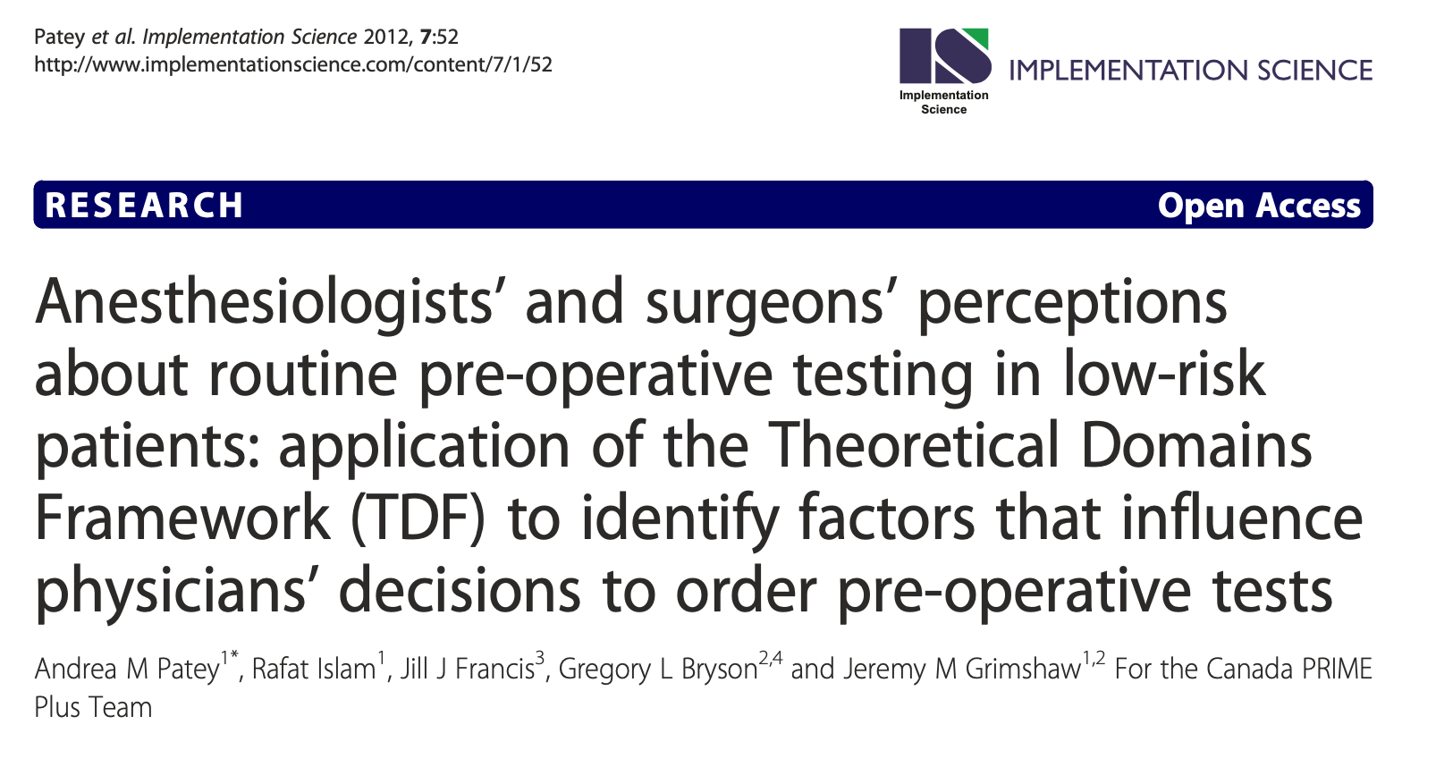
Studying Barriers to Change

Slide 19
Findings
Conflict over who was responsible for ordering tests
Most tests were completed before being seen by anesthesia
Surgeons ordered tests on possibility that anesthesia might want them
Perceived inability to cancel tests ordered by others
Tests often ordered to appease the most conservative colleague

Slide 20
TOH Standardization of Preop Testing (2015)
Local champions:
Drs Greg Bryson, Pat Sullivan, Sylvain Gagné
Developed an evidence based medical directive deciding a priori when and for whom tests were indicated
Agreed upon by all stakeholders (surgery/anesthesia)
Directive was automatically carried out by nursing staff

Slide 21
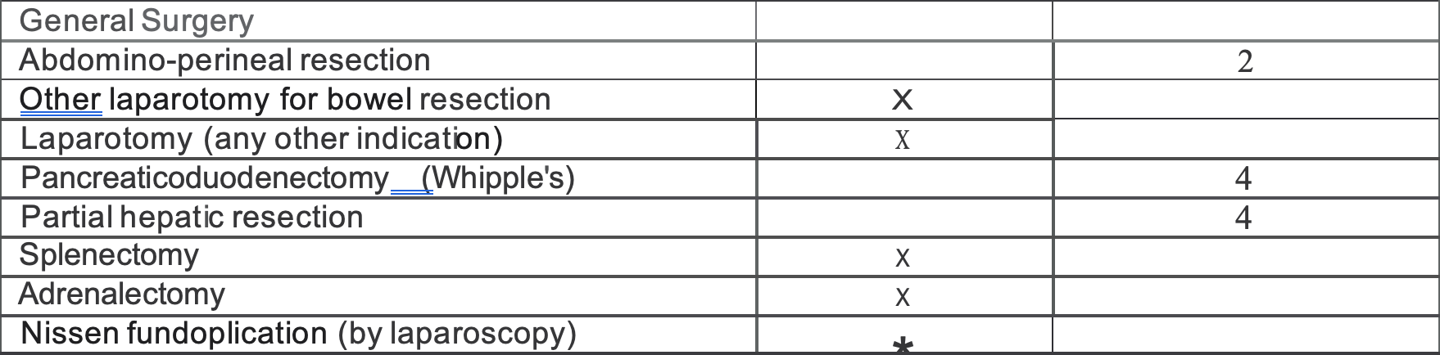
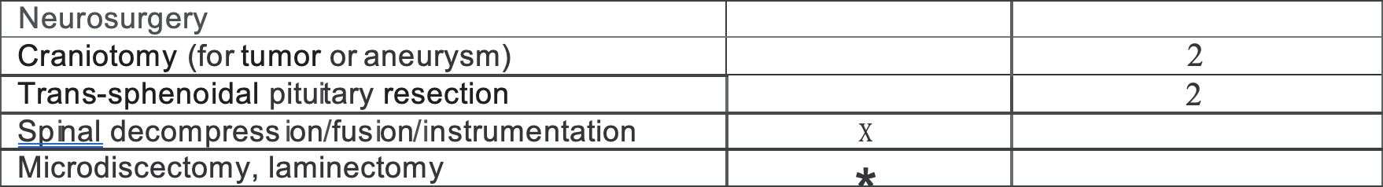
TOH Medical Directive (2015) - snapshot
Notes:
Asterisk indicates that T&S required only if:
POCT Hgb < 120
Hx of coagulopathy
<50Kg
Hx of chronic transfusion (hemophilia, thalassemia, sickle cell, etc.
CAD with ongoing angina

Slide 22
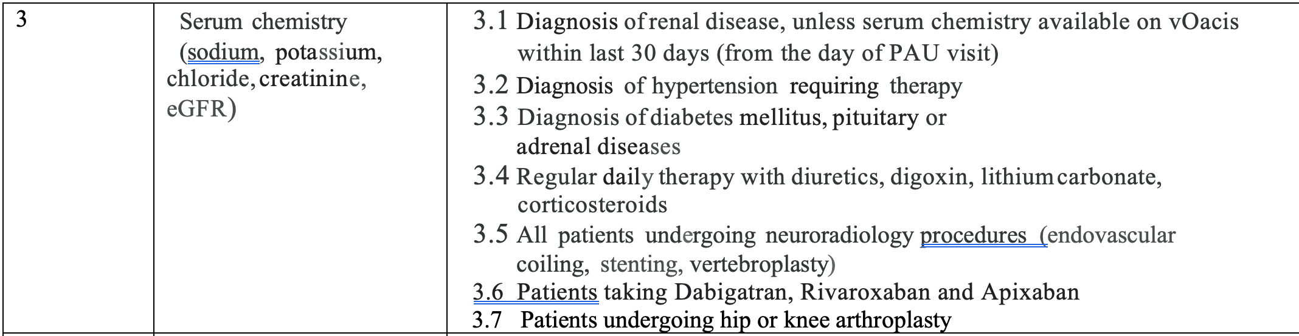
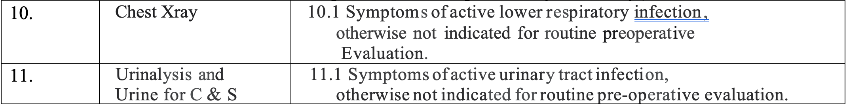
TOH Medical Directive (2015)

Slide 23
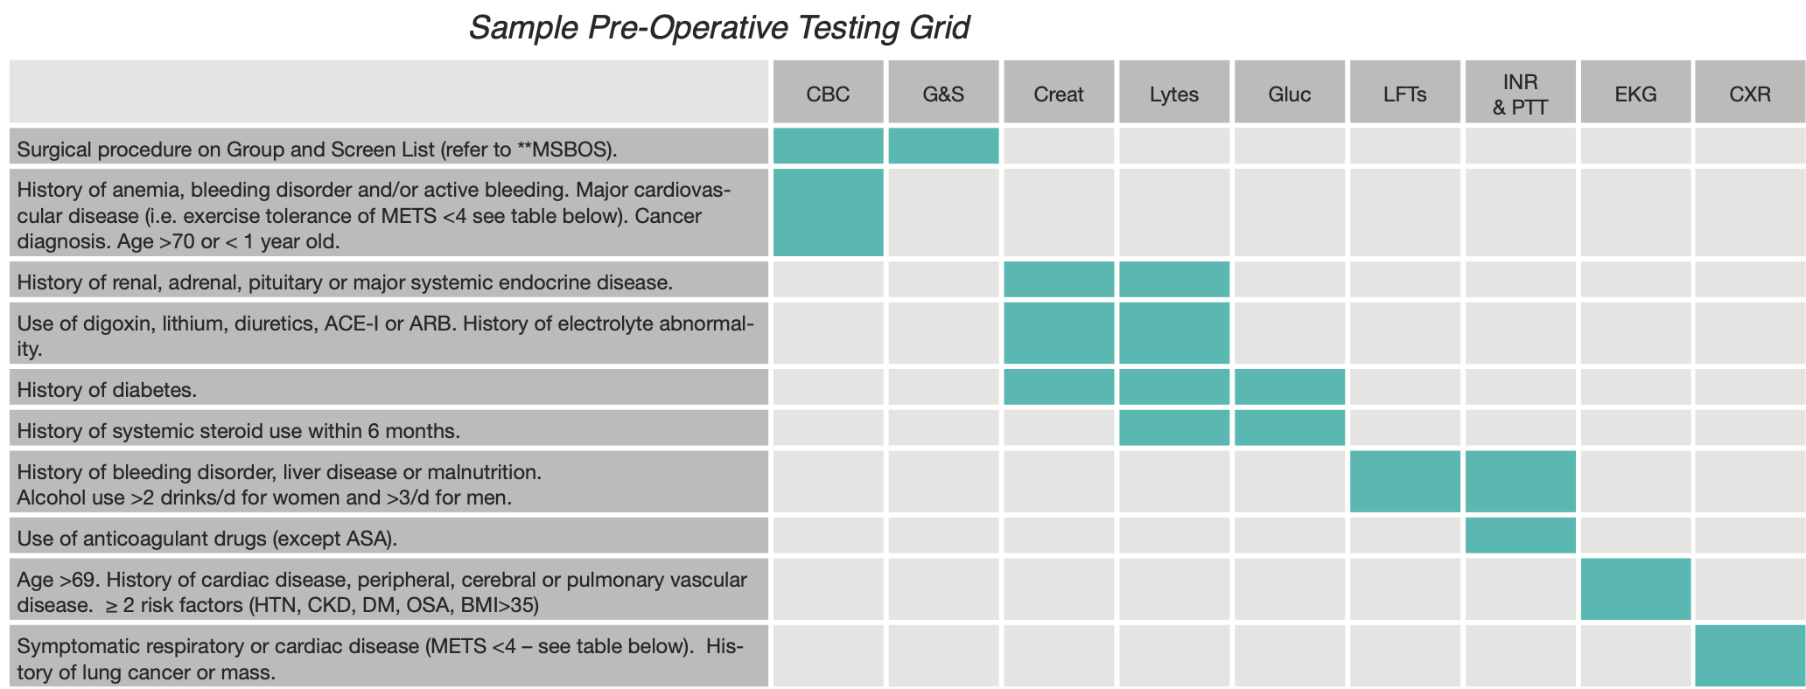
Another Sample Preop Order Protocol (North York General Hospital, Toronto)

Slide 24
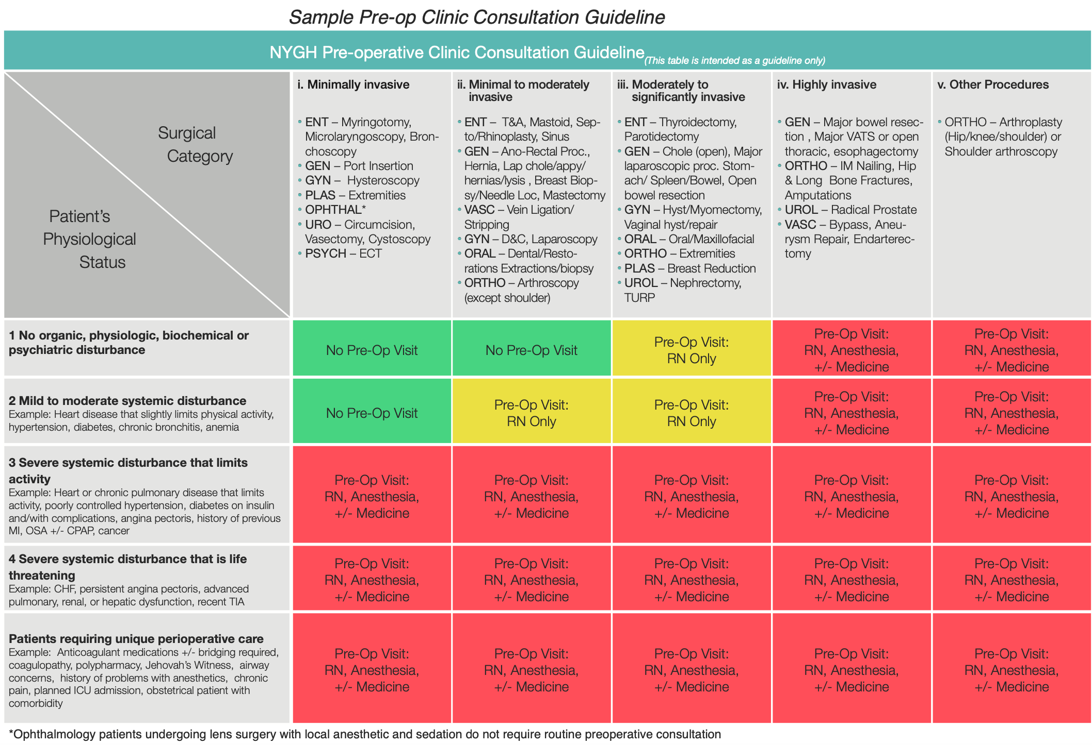
Sample Preop Consult Decision Guide - North York General Hospital,Toronto

Slide 25
More TOH Anesthesia Initiatives
ETT initiative (STOP preparing unwrapped “just in case” ETTs!)
Cut back on drawing up emergency medications for every case
Hotline setup only as needed
Reduction in preop (PAU) ECHO ordering
Education/protocol re pacemaker consultation
Discontinuation of Anesthesia consults for cataract pts
Removal of anesthesia from cataract lists? (WIP...)

Slide 26


CAS Top Five Recommendations (2015)
Do not order baseline BW (CBC, coags, lytes) for asymptomatic pts undergoing low-risk non-cardiac surgery
Do not order baseline EKGs for asymptomatic pts undergoing low-risk non-cardiac surgery
Do not order baseline CXR for asymptomatic pts except as part of surgical/oncologic evaln
Do not perform ECHO as part of a preop assessment for asymptomatic pts undergoing low/intermediate-risk surgery
Do not perform cardiac stress test for asymptomatic pts undergoing low to intermediate risk non-cardiac surgery
Notes:
How the list was created
The Canadian Anesthesiologists’ Society (CAS) established its Choosing Wisely Canada (CWC) Top 5 recommendations by engaging a small team of expert Canadian anesthesiologists to develop research methodology and carry out a survey to establish the CAS top five recommendations. The survey was based on similar work done by the American Society of Anesthesiologists who identified an evidence-based list of activities to question within anesthesiology as Five Things Physicians and Patients Should Question: American Society of Anesthesiologists. The CAS team defined a short list of twelve tests and procedures in perioperative care and asked members of the CAS to consider each and answer questions about their frequency of use, impact on quality of the care for patients, cost of the investigation, evidence to support the investigation and potential to avoid ordering the investigation. Five recommendations were selected through survey data collection and analysis by the CAS research team in conjunction with a professional survey consultant and expert consensus. The top five were presented at the CAS Annual Meeting in June 2015 and will be published in the Canadian Journal of Anesthesia.

Slide 27
There are MANY more opportunities to reduce waste!
We cannot afford to continue with our unsustainable status quo...

Slide 28
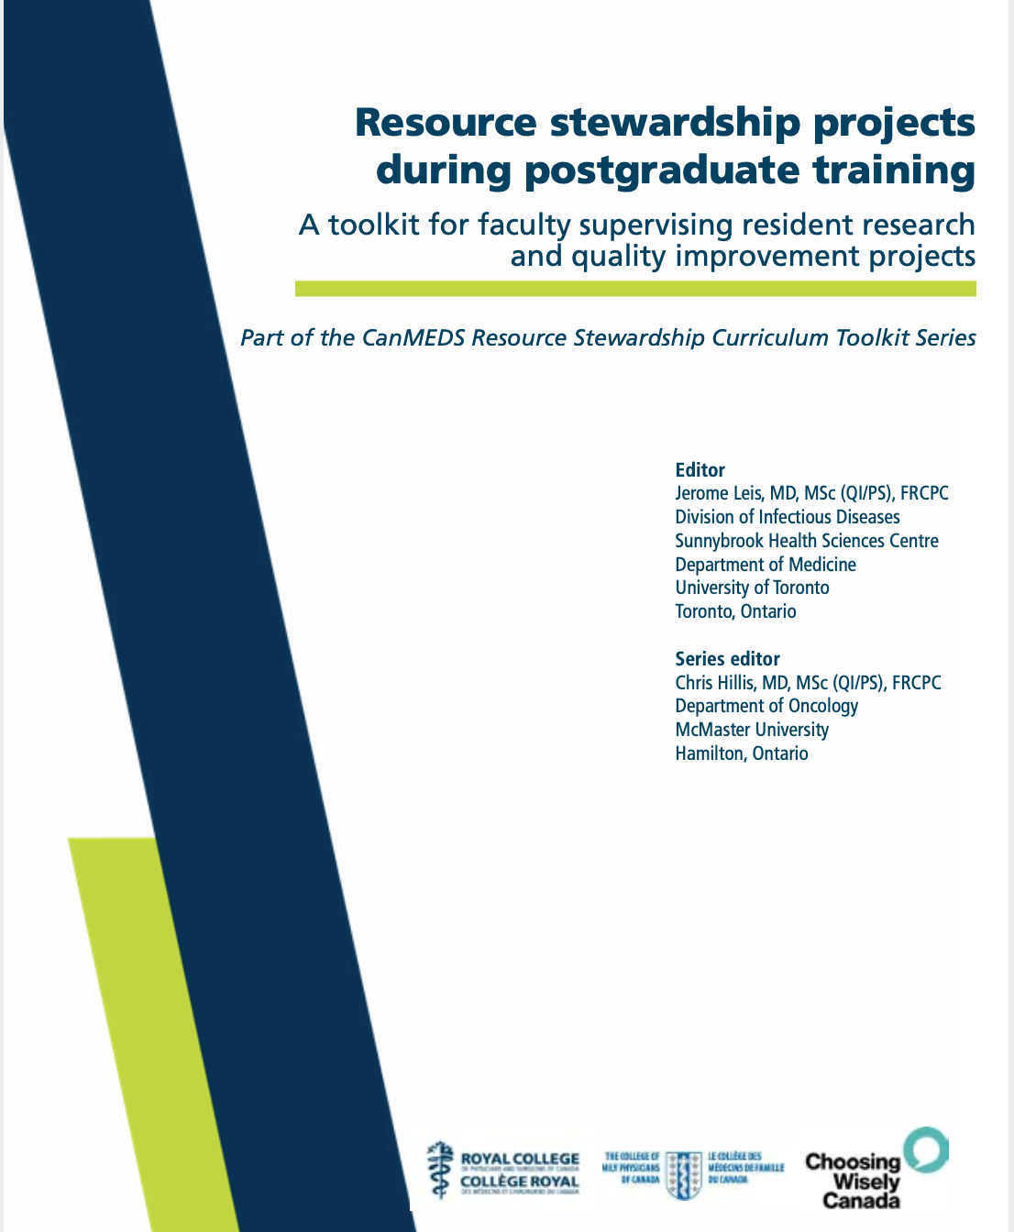
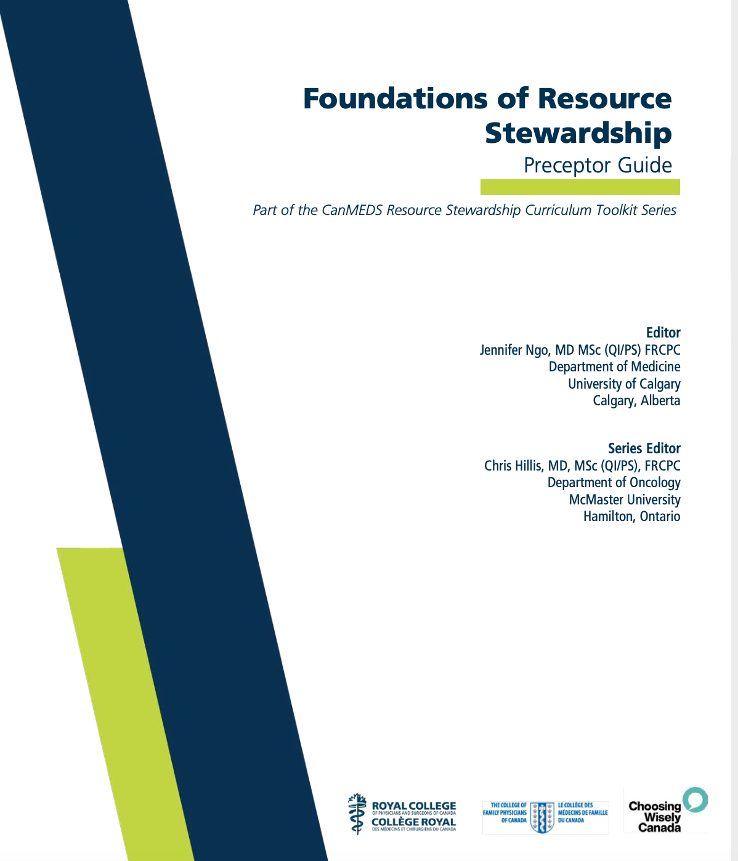

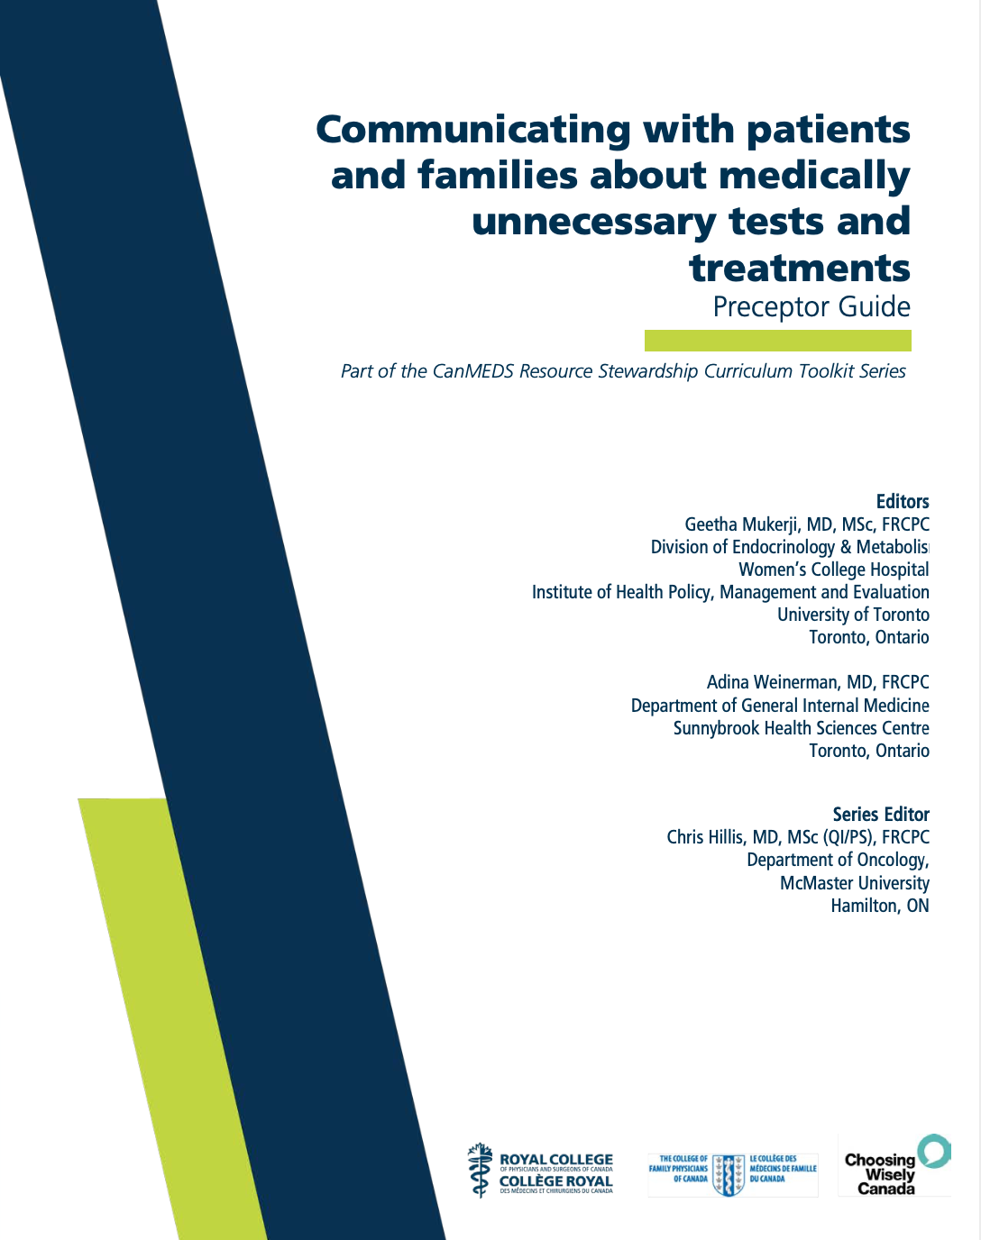
Resource Stewardship Resources

Slide 29
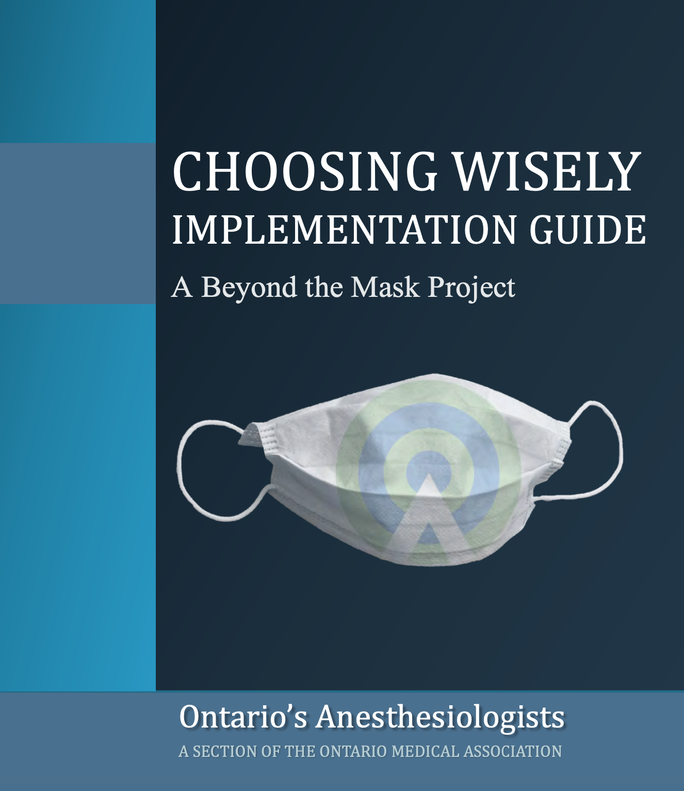

Resource Stewardship Resources
Full “How To” guide
Anesthesia specific
Case studies
Variety of approaches
Change mgmt. advice

Slide 30
The End!

Slide 31
This work is licensed under CC BY-NC-SA 4.0. To view a copy of this license, visit: https://creativecommons.org/licenses/by-nc-sa/4.0/

